Slide 1

Space Shooter – Episode 02
Notes:
In this presentation we’ll add more elements to our Space Shooter game.

Slide 2
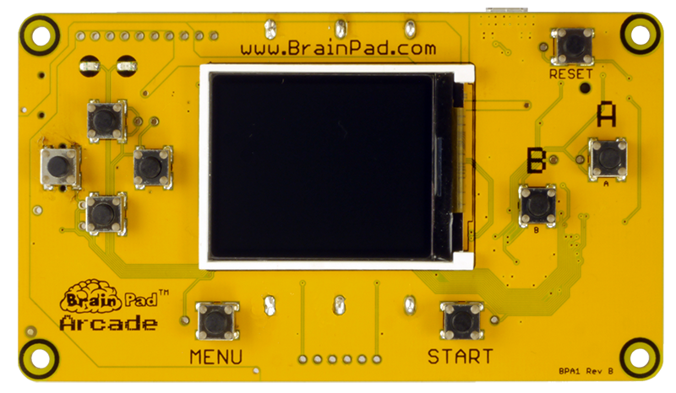
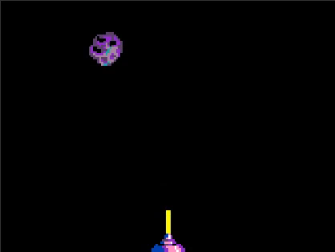
Let’s add something to shoot at in our new game!!
Notes:
Let’s add something to shoot at in our game.

Slide 3
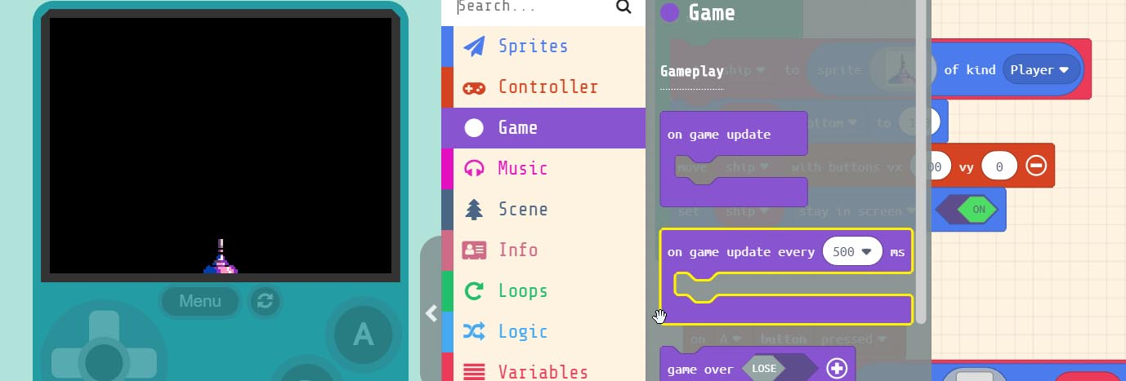
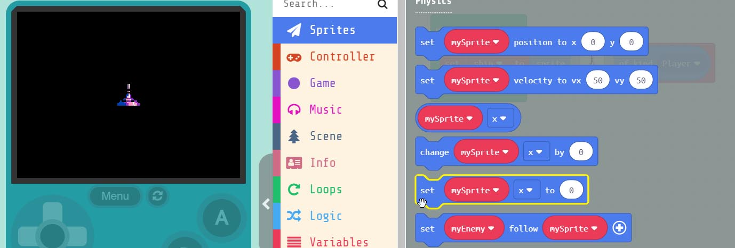
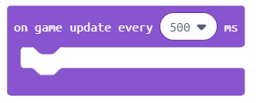
Grab the block.
This event block runs the code at specific intervals. In this case every 500 milliseconds.
Notes:
First we need to grab the ‘on game update every 500 ms’ block. It can be found under ‘Game’ in the menu. This type of event block runs whatever code we put inside it every ½ a second which is 500 milliseconds. Drag this block into the work area.

Slide 4
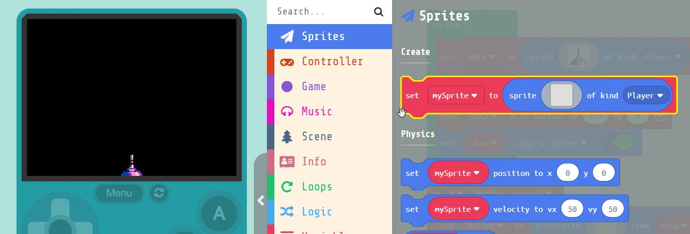
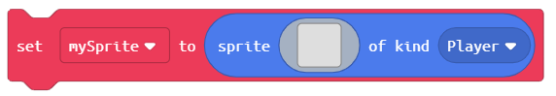
Grab the block.
We need this block to create a new Sprite. Drag into the block
Notes:
Next, we’ll create an enemy to shoot at. To do this we need to add another Sprite to the project. Grab the ‘set mySprite to’ block and put it inside the ‘on game update’ block we just added to the work area.

Slide 5
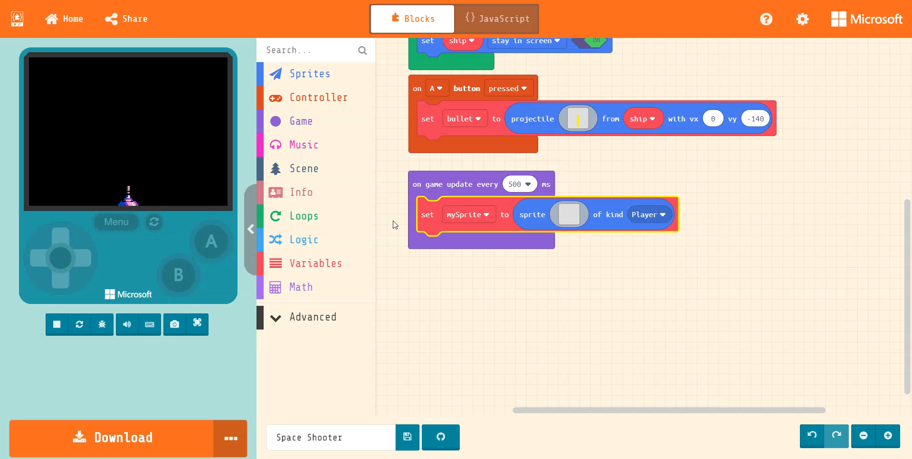
Notes:
Now let's add an Asteroid Sprite to the block. To do this click on the blank gray box inside the ‘set mySprite’ block. This will bring up the Sprite editor. This is where Sprites are created or selected. We will grab one of the pre-created Sprites from the ‘Gallery’. Click on gallery and scroll down until you see one of the ‘Asteroids’, select it and press ‘DONE’

Slide 6
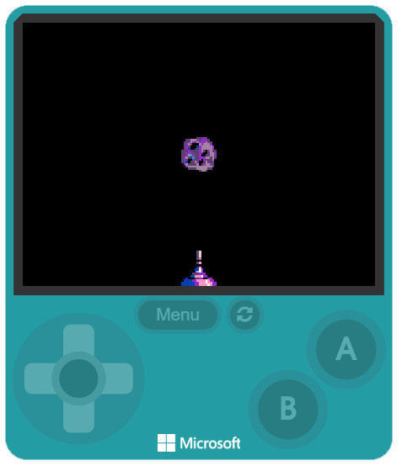
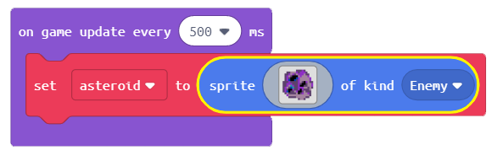
Change ‘mySprite’ to ‘asteroid’
We also need to change the kind
to ‘Enemy’
Notes:
Now that we have an asteroid on the screen lets change the parameters inside the block. First change ‘mySprite’ to ‘asteroid’. Remember what we said about meaningful names for our variables? We also need to change what kind of Sprite it is. In this case we need to change it to ‘Enemy’

Slide 7
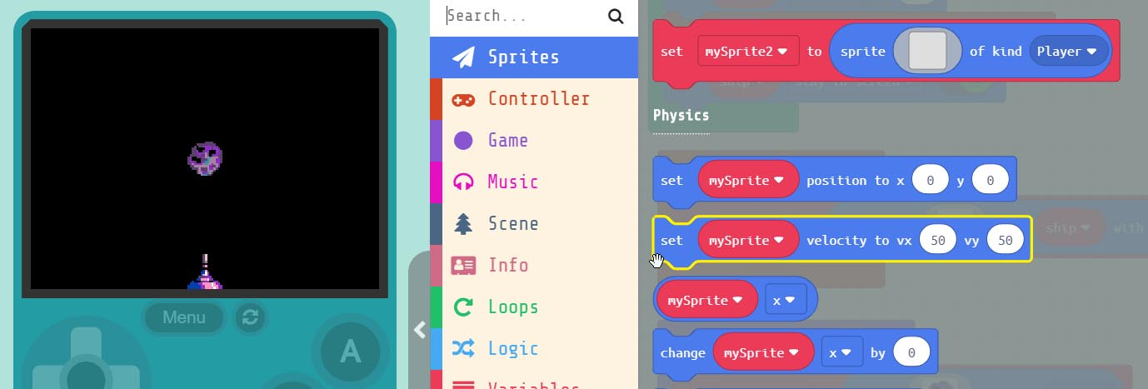
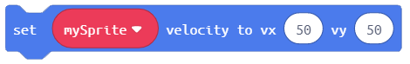
Grab the block.
Add this block just below the ‘asteroid’ sprite block
inside the block
Notes:
Let’s make our ‘asteroid’ fall from the sky. To do this we need to grab the ‘set mySprite velocity’ block. Add this block to the bottom of our ‘on game update’ block in the work area.

Slide 8
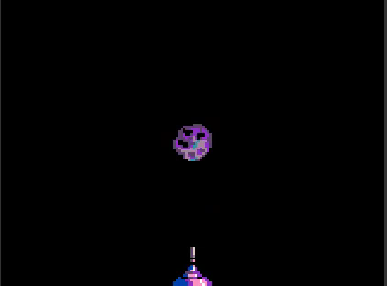
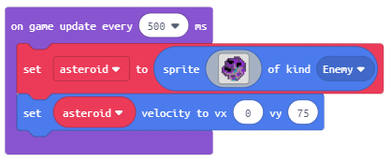
Change ‘mySprite’ to ‘asteroid’
We need to set the speed the
that the asteroid will fall at.
We do this by changing vx = 0 & vy = 75
Notes:
Change ‘mySprite’ to asteroid. Next change the vx=0 which means that it won’t move in the X direction. Set the vy to ‘75’ this is how fast the asteroid will fall on the Y – axis. But as you can see our ‘asteroid’ starts in the default center and just falls straight down on the player. Let’s add a new block to make the ‘asteroid’ start at the top of the screen.

Slide 9
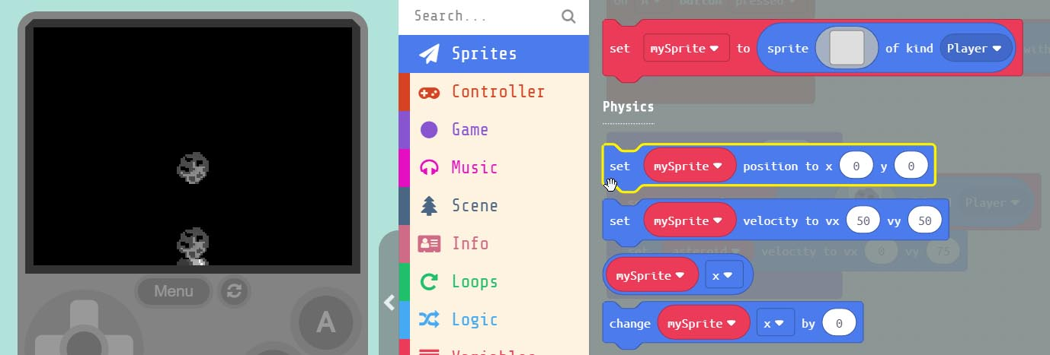
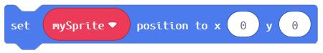
Grab the block.
Add this block to the bottom of the block
Notes:
Now grab the ‘set mySprite position’ block from the menu under ‘Sprites’ drag this block to the bottom of our ‘on game update every 500 ms’ block.

Slide 10
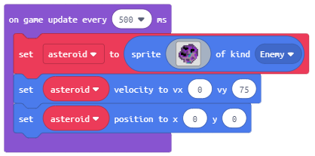
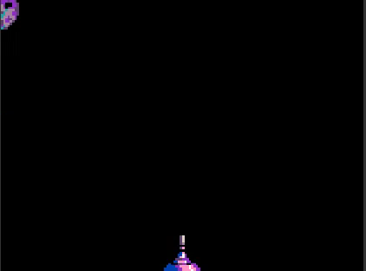
Change ‘mySprite’ to ‘asteroid’
But it’s still not right, our ‘asteroid’
only falls from the top left corner. Let’s make it start at a random spot
at the top of the screen.
Notes:
Change ‘mySprite’ to asteroid. This sets the ‘asteroid’ start position to the top left corner of the screen. But it’s still not exactly what we want. The ‘asteroid’ only falls from the corner. Let’s make it start at a random spot at the top of the screen.

Slide 11
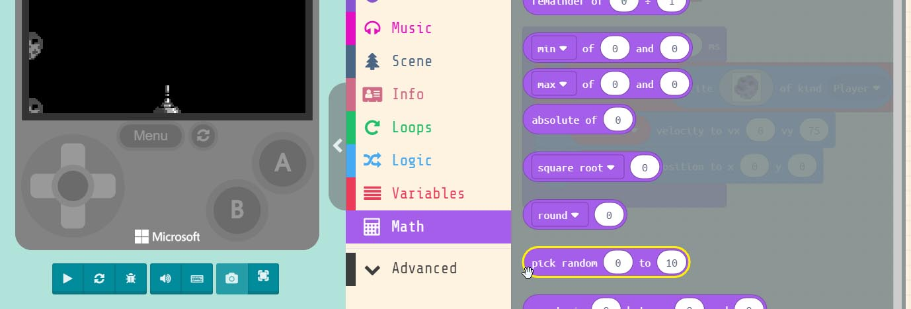
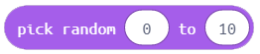
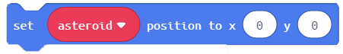
Grab the block.
Put it inside the ‘x’ parameter
in the block
Notes:
To make our asteroid start in a random location we need to grab the ‘pick random 0 to 10’ block found under ‘Math’ in the menu. Drag this and put it inside the ‘X’ value window inside our ‘set asteroid position’ block.

Slide 12
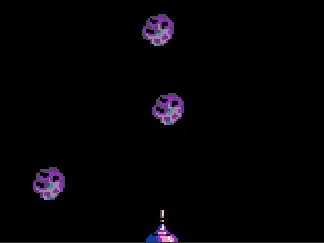
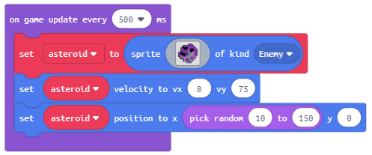
Now let’s change the parameters
inside the random block.
Change the first value to 10
And the second value to 150
Notes:
Now we need to change the parameters inside the ‘pick random’ block we just added. Change the first parameter to ’10’ and the second one to ‘150’. Now our asteroids are randomly generated at the top of the screen and fall towards our player.

Slide 13
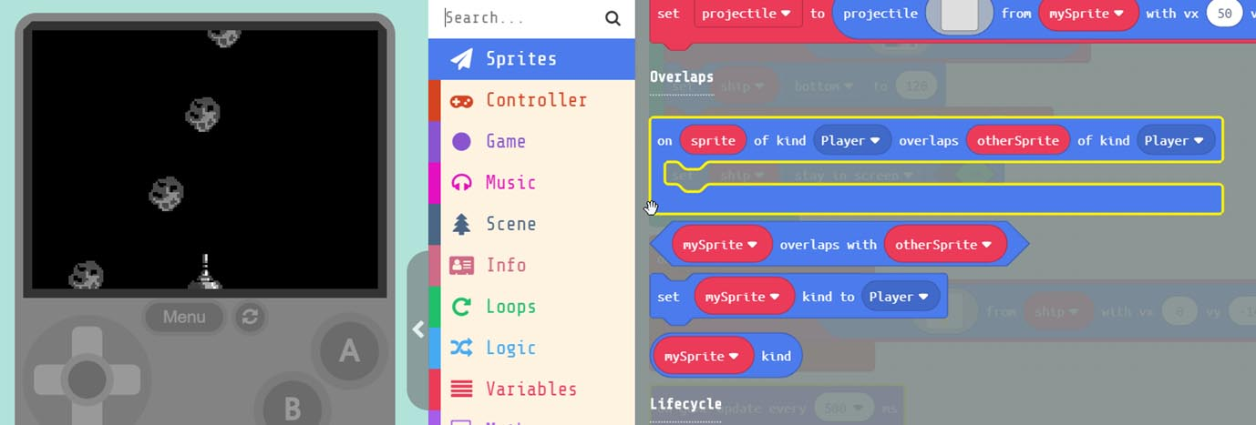
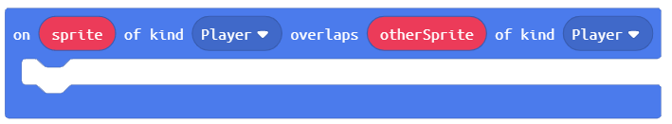
Grab the block.
Drag this ‘Event’ block into the work area
Notes:
You may have tried to shoot at the ‘asteroid’ and nothing happened. We need to add collision detection to our game. Under ‘Sprites’ in the menu select the ‘on sprite of kind player overlaps with otherSprite’ Event block. Remember that events are standalone blocks that run the code inside them when something happens. In this case when we have an overlap of Sprites.

Slide 14
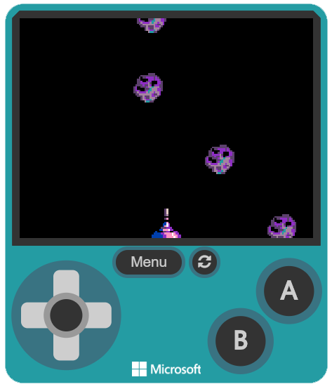
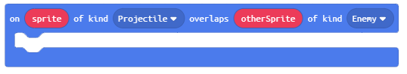
Now let’s change the parameters
inside our ‘overlap’ block.
We need to change the first kind
to ‘Projectile’ and the
the last kind to ‘Enemy’
Notes:
We need to change the kind of Sprites we want to detect when overlapping. Change the first kind from ‘Player’ to “Projectile’, next change the last kind from ‘Player’ to ‘Enemy’. So now when a ‘Projectile’, our ‘bullet’, overlaps an ‘Enemy’, our Asteroids, the code we place inside this block will run.

Slide 15
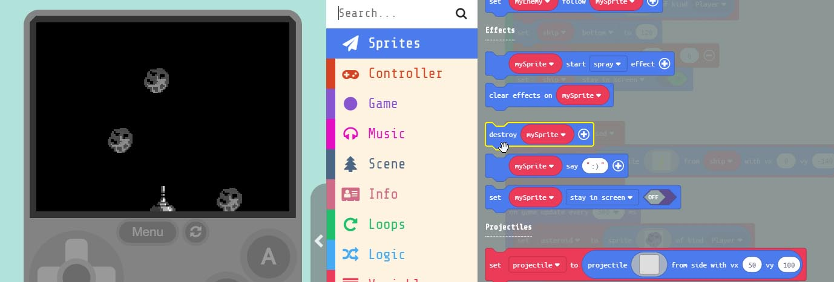
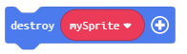
Grab the block.
Put inside our Event block.
Notes:
You may have tried to shoot at the ‘asteroid’ and nothing happened. We need to add collision detection to our game. Under ‘Sprites’ in the menu select the ‘on sprite of kind player overlaps with otherSprite’ Event block. Remember that events are standalone blocks that run the code inside them when something happens. In this case when we have an overlap of Sprites.

Slide 16
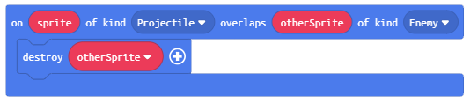
We need to create a ‘NEW’
variable called ‘otherSprite’
This ensures that every time our
‘projectile’ overlaps the ‘otherSprite’
that is of kind ‘Enemy’ we destroy it.
Notes:
We need to create a new variable by clicking the down arrow inside the ‘destroy mySprite’ block. We need to name the new variable ‘otherSprite’. This ensures that every time our ‘projectile bullet’ overlaps the ‘otherSprite’ that is an “Enemy’ the ‘otherSprite’ will be destroyed. You ask, why we don’t set this to destroy ‘asteroid’ instead? If we did this then hitting just one ‘asteroid’ Sprite with our bullet, would destroy ALL the asteroids on the screen.

Slide 17
Hardware Break
Now let’s load what we have on to the BrainPad
Notes:
Now let’s load what we have so far on the BrainPad.

Slide 18
EXTRA
CREDIT
Notes:
Now let’s load what we have so far on the BrainPad.

Slide 19

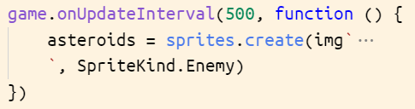
Code to Blocks:
JavaScript:
Block:
Notes:
Now you may have noticed that ‘on A button pressed’ block looks different then the other blocks. It looks more like the ‘on start’ block, like a square. This is because it’s what is known as an ‘EVENT’ block. An ‘EVENT’ block runs the code we place inside of it when an ‘EVENT’ occurs. Like a button press. ‘on start’ is an ‘EVENT’ too. The first time we run our program, everything inside of it runs.

Slide 20
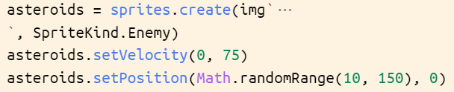
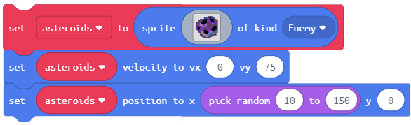
Code to Blocks:
JavaScript:
Block:
Notes:
Now you may have noticed that ‘on A button pressed’ block looks different then the other blocks. It looks more like the ‘on start’ block, like a square. This is because it’s what is known as an ‘EVENT’ block. An ‘EVENT’ block runs the code we place inside of it when an ‘EVENT’ occurs. Like a button press. ‘on start’ is an ‘EVENT’ too. The first time we run our program, everything inside of it runs.

Slide 21
Code to Blocks:
JavaScript:
Block:
Notes:
Now you may have noticed that ‘on A button pressed’ block looks different then the other blocks. It looks more like the ‘on start’ block, like a square. This is because it’s what is known as an ‘EVENT’ block. An ‘EVENT’ block runs the code we place inside of it when an ‘EVENT’ occurs. Like a button press. ‘on start’ is an ‘EVENT’ too. The first time we run our program, everything inside of it runs.

